Slide 1
Wireless and Mobile Network Architecture
Chapter 2: Mobility Management
Prof. Yuh-Shyan Chen
Department of Computer Science and Information Engineering
National Taipei University
Sep. 2006

Slide 2
Outline
Introduction
Handoff
Roaming Management
Roaming Management through SS7
Summary

Slide 3
Introduction
In the PCS system architecture (Fig. 2.1), the mobile service area is covered by a set of BSs which are responsible for relaying the call to/from the MSs
The BSs are connected to MSCs by land links.
MSC interfaces the MSs (via BSs) with the PSTN

Slide 4
Cont.
Two types of databases are used for roaming management
  Home Location Register (HLR)
  Visitor Location Register (VLR)
Examples of the protocols to support mobility management
  EIA/TIA Interim Standard 41 (IS-41 or ANSI-41)
  GSM Mobile Application Part (MAP)

Slide 5
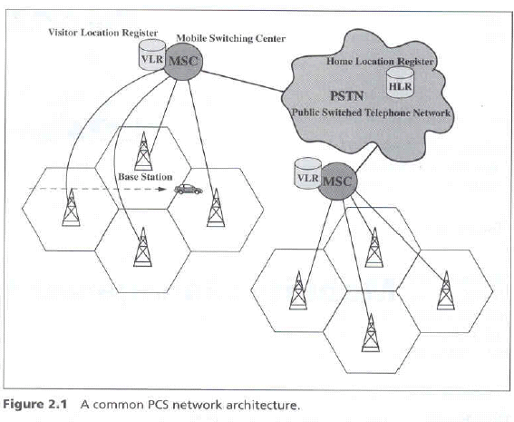
Fig. 2.1 A common PCS network architecture

Slide 6
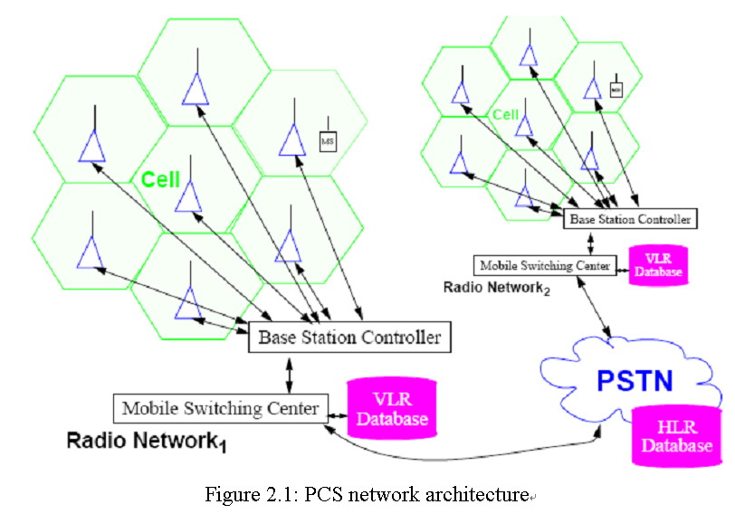
Fig. 2.1 A common PCS network architecture

Slide 7
Two Aspects of Mobility in a PCS Network
Handoff (link transfer, or handover)
  When a mobile user is engaged in conversion, the MS is connected to a BS via a radio link
  If the mobile user moves to the coverage area of another BS, the radio link to the old BS is disconnected, and a radio link to the new BS should be established to continue the conversation
Roaming
  When a mobile user moves from one PCS system (e.g., the system in Chiayi) to another (e.g., the system in Taipei), the system should be informed of the current location of the user

Slide 8
Three Strategies for Handoff Detection
Mobile-Controlled Handoff (MCHO)
  MCHO is used in DECT and PACS
  The MS continuously monitors the signal of the surrounding BSs,
  The MS initiates the handoff process when some handoff criteria are met.
Network-Controlled Handoff (NCHO)
  NCHO is used in CT-2 plus and AMPS
  The surrounding BSs measure the signal from the MS
  The network initiates the handoff process when some handoff criteria are met.

Slide 9
Cont.
Mobile-Assisted Handoff (MAHO)
  MAHO is used in GSM and IS-95
  The network asks the MS to measure the signal from the surrounding BSs,
  The network makes the handoff decision based on reports from the MS

Slide 10
Inter-BS Handoff
The new and old BSs are connected to the same MSC (Assumed that the need for handoff is detected by MS)
  The MS momentarily suspends conversation and initiates the handoff procedure by signaling on an idle channel in the new BS. Then it resumes the conversation on the old BS.
    Fig. 2.2(a)

Slide 11
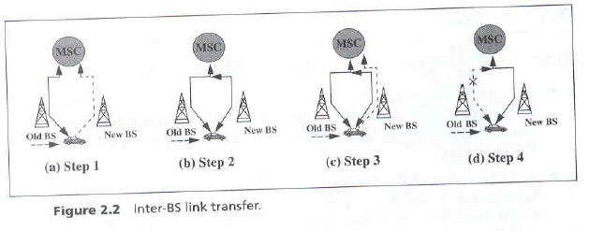
Fig. 2.2 Inter-BS link transfer

Slide 12
Cont.
  Upon receipt of the signal, the MSC transfers the encryption information to the selected idle channel of the new BS and sets up the new conversation path to the MS through that channel. The switch bridges the new path with the old path and informs the MS to transfer from the old channel to the new channel.
    Fig. 2.2(b)

Slide 13
Cont.
  After the MS has been transferred to the new BS. It signals the network, and resumes conversation using the new channel
    Fig. 2.2(c)
  Upon receipt of the handoff completion signal, the network removes the bridge from the path and releases resources associated with the old channel.
    Fig. 2.2(d)

Slide 14
Cont.
For NCHO, all handoff signaling messages are exchanged between the MS and the old BS through the failing link. Thus, the whole process must be completed as quickly as possible.
If the new BS does not have an idle channel, the handoff call may be dropped (forced to terminate).
Forced termination of an ongoing call is considered less desirable than blocking a new call attempt.

Slide 15
Channel Assignment Schemes for Handoff Calls
Nonprioritized Scheme
  The networks handle a handoff in the same manner as a new call attempt
Reserved Channel Scheme
  Similar to the nonprioritized scheme, except that some channels in each BS are reserved for handoff calls

Slide 16
Cont.
Queuing Priority Scheme
  Based on the fact that adjacent coverage areas of BSs overlap
  There is a considerable area where a call can be handled by either BS, which is called the handoff area
  If no new channel is available in the new BS during handoff, the new BS buffers the handoff request in a waiting queue.
  The MS continues to use the channel with the old BS until either a channel in the new BS becomes available

Slide 17
Cont.
Subrating Scheme
  The new BS creates a new channel for a handoff call by sharing resources with an existing call if no free channel is available.
  Subrating means an occupied full-rate channel is temporarily divided into two channels at half the original rate.
  One half-rate channel is to server the exiting call, and the other half-rate channel is to serve the handoff request
  When occupied channels are released, the subrated channels are immediately switched back to the full rate channels.

Slide 18
2.1.2 Intersystem Handoff
Step 1
  MSC A requests a MSC B to perform handoff measurements on the call in progress.
  MSC then selects a candidate BS, BS2, and interrogates it for signal quality parameters.
  MSC B returns the signal quality parameters, along with other relevant information, to MSC A.

Slide 19
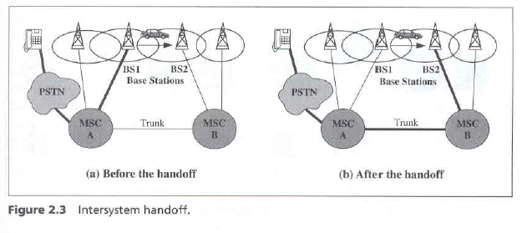
Fig. 2.3 Intersystem handoff

Slide 20
Cont.
Step 2
  MSC A checks if the MS has made too many handoffs recently (e,g,, to avoid that MS is moving within overlapped area) or if intersystem trunks are not available.
  If so, MSC A exists the procedure
  Otherwise, MSC A asks MSC B to set up a voice channels.

Slide 21
Cont.
Step 3
  MSC A sends the MS a handoff order
  The MS synchronizes to BS 2.
  After the MS is connected to BS 2, MSC B informs MSC A that the handoff is successful.
MSC A is referred to as the anchor MSC, and is always in the call path before and after the handoff.

Slide 22
Anchor Approach
If the MS moves back to MSC A again, the connection between MSC A and MSC B is removed.
If the MS moves to the third MSC C, the MSC B will be in the call path.
Path Minimization
  When the MS moves to the third MSC, the second MSC may be removed from the call path
  The link between MSC A and MSC B is disconnected, and MSC C is connected MSC A directly.

Slide 23
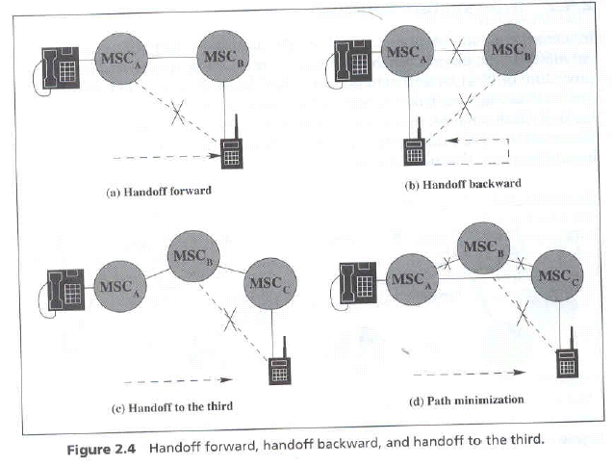
Fig. 2.4 Handoff forward, handoff backward, and handoff to the third

Slide 24
2.2 Roaming Management
Two basic operations in roaming management are
  Registration (or Location Update)
    The process whereby an MS informs the system of its current location
  Location Tracking
    The process during which the system locates the MS (this process is required when the network attempts to deliver a call to the mobile user)

Slide 25
Cont.
The roaming management schemes proposed in IS-41 and GSM MAP are two-level strategies
They use a two-tier system of home and visited databases that are
  Home Location Register (HLR).
  Visited Location Register (VLR).

Slide 26
Home Location Register (HLR)
When a user subscribes to the services of a PCS network, a record is created in the system’s database
  Which is referred as to the home system of the mobile user.
HLR is a network database that stores and manages all subscriptions of a specified operator.

Slide 27
Cont.
The information contained in HLR includes
  MS identity
  Directory number
  Profile information
  Current location
  Validation period

Slide 28
Visitor Location Register (VLR)
When the mobile user visits a PCS network other than the home system, a temporary record for the mobile user is created in the visitor location register (VLR) of the visited system.
The VLR temporarily stores subscription information for the visiting subscribers.

Slide 29
Cont.
The MSC (corresponding with the VLR) can provide service to the mobile user.
The VLR is the “other” location register used to retrieve information for handling calls to/from a visiting mobile users.

Slide 30
MS Registration Process (Fig. 2.5)
Step 1
  Suppose that the home system of a mobile user is in Morristown. When the mobile user moves from one visited system (e.g., New York City) to another (e.g., Los Angeles), it must register in the VLR of the new visited system.
Step 2
  The new VLR informs the mobile user’s HLR of the person’s current location (the address of the new VLR)
  The HLR sends an ACK., which includes the MS’s profile, to the new VLR

Slide 31
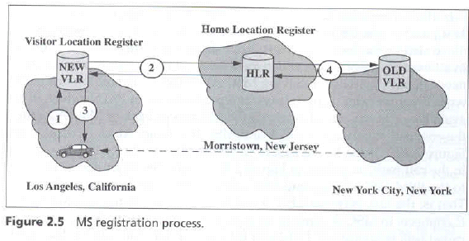
Fig. 2.5 MS registration process

Slide 32
Cont.
Step 3
  The new VLR informs the MS of the successful registration.
Step 4
  After Step 2, the HLR also sends a deregistration message to cancel the obsolete location record of the MS in the old VLR.
  The old VLR acknowledges the deregistration.

Slide 33
Call Origination Procedure
To originate a call, the MS executes the following steps.
  MS contacts the MSC in the visited PCS network.
  The call request is forwarded to the VLR for approval.
  If the call is accepted, the MSC sets up the call to the called party following the standard PSTN call setup procedure.

Slide 34
Call Delivery (Call Termination/Location Tracking) (Fig. 2.6)
Step 1
  If a wireline phone attempts to call a mobile subscriber, the call is forwarded to a switch, called the originating switch in the PSTN.
  The originating switch queries the HLR to find the current VLR of the MS.
  The HLR queries the VLR in the which the MS resides to get a routable address.

Slide 35
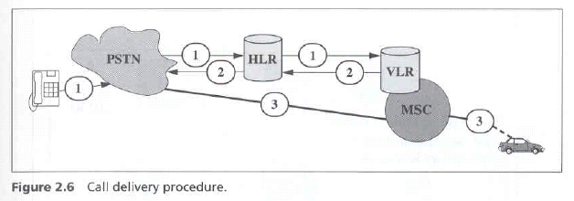
Fig. 2.6 Call delivery procedure

Slide 36
Cont.
  Note that, if the originating switch is not capable of querying the HLR (i.e., it is not equipped to support mobility), the call is routed through the PSTN to the subscriber’s Gateway MSC, which queries the HLR to determine the current VLR serving the MS.
Step 2
  The VLR returns the routable address to the originating switch through HLR.
Step 3
  Based on the routable address, a trunk (voice circuit) is set up from the originating switch to the MS through the visited MSC.

Slide 37
Roaming Management under SS7
How is mobile roaming managed by the PSTN signaling
  By using SS7.
Signaling System No. 7 (SS 7) is a Common Channel Signaling (CCS) system.

Slide 38
Cont.
SS7 is developed to satisfy the telephone operating companies’ requirement for an improvement to the earlier signaling systems, which is lacked the sophistication required to deliver mush more than plain old telephone service (POTS).
Signaling between a PCS network and the PSTN are typically achieved by the SS7 network.

Slide 39
Common Channel Signaling (CCS)
CCS is a out-of-band signaling network that provides control and management functions in the telephone network.
CCS consists of
  Supervisory functions
  Addressing
  Call Information Provisioning

Slide 40
Cont.
Functions provided by CCS are
  To convey messages to initiate and terminate calls
  To determine the status of some part of the network
  To control the amount of traffic allowed

Slide 41
Three Distinct Components of SS7 (Fig. 2.7)
Service Switching Point (SSP)
  A telephone switch interconnected by SS7 links.
  The SSPs perform call processing on calls that originate, tandem, or terminate at that nodes.
  A local SSP in the PSTN can be central or end office (EO).
  An SSP in a PCS network is called a mobile switching center (MSC).

Slide 42
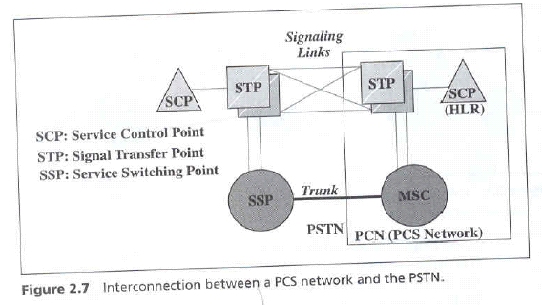
Fig. 2.7 Interconnection between a PCS and the PSTN

Slide 43
Cont.
Signal Transfer Point (STP)
  A switch that reply SS7 message between network switched and databases
  Based on the address fields of the SS7 messages, the STPs route the message to the correct out-going signal links.
  For the reliability requirements, STPs are provisioned in mated pairs.

Slide 44
Cont.
Service Control Point (SCP)
  SCP contains databases for providing enhanced services.
  An SCP accepts queries from an SSP and returns the requested information to the SSP.
  In mobile applications, an SCP may contains an HLR or VLR.
In SS7 network, the trunks (voice circuits) connects SSPs to carry user data/voice information.

Slide 45
Cont.
The signaling links connects SCPs to STPs, and STPs to SSPs.
The SSPs and SCPs are connected indirectly through STPs.

Slide 46
Registration through SS7
Example: the MS moves from VLR1 to VLR2.
Step 1
  The MS enters the area controlled by MSC2.
  MSC 2 lunches a registration query to its VLR through STP2, assuming that VLR2 and MSC2 are not co-located.
Step 2
  VLR2 sends a registration message to the MS’s HLR (HLR4).

Slide 47
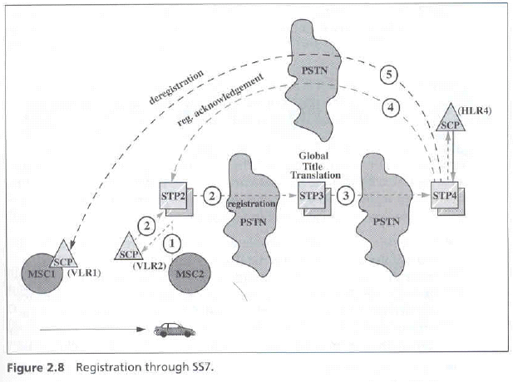
Fig. 2.8 Registration through SS7

Slide 48
Cont.
  VLR2 may not know the actual address of HLR. Instead, VLR2 sends the message to containing the MS identity, called Mobile Identification Number (MIN), to an STP (STP3) that can translate the MIN into the HLR address.
Step 3
  The MIN-to-HLR address translation is performed at STP3 by a table-lookup technique called Global Title Translation (GTT). STP3 the forwards the registration message to HLR.

Slide 49
Cont.
Step 4
  After the registration, HLR sends an acknowledgement back to VLR2. Since the address of VLR2 is known, the acknowledgement may be sent to VLR2 using a shortcut, without passing through STP3.
Step 5
  After Step 3, HLR sends a deregistration message to VLR1 to cancel the obsolete record. VLR1 then acknowledges the cancellation.

Slide 50
Reducing the “Cost” of Deregistration
Approach 1: Implicit Deregistration
  Obsolete VLR records are deleted until the database is full.
  If the database if full when an MS arrives, a record is deleted, freeing storage space to accommodate the newly arrived MS.
  A replacement policy is required to select a record for replacement. (Note that a valid record is replaced, and the information is lost).
Advantage
  No deregistration message are sent among the SS7 network elements.

Slide 51
Cont.
Approach 2: Periodic Re-registration.
  The MS periodically re-registers to the VLR.
  If the VLR does not receive the re-registration message within a timeout period, the record is deleted
Advantage
  This approach only creates local message traffic between the MSC and the VLR.
  No SS7 messages are generated if the VLR is co-located with the MSC.

Slide 52
Reducing the Registration Traffic – Pointer Forwarding Scheme
Move Operation (registration)
  When an MS moves from one VLR to another, a pointer is created from the old VLR to the new VLR.
  No registration to the HLR is required.
Find Operation (call delivery)
  When the HLR attempts to locate the MS for call delivery, the pointer chain is traced.
  After the find operation, the HLR points directly to the destination VLR.

Slide 53
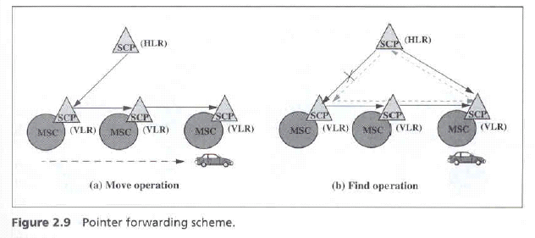
Fig. 2.9 Pointer forwarding scheme

Slide 54
Call Delivery through SS7
Similar to the registration process, visited to several STPs, and a GTT maybe required to access the HLR in call delivery
Several STPs may be visited to obtain the routable address from the VLR.
To reduce the call delivery traffic, a cache scheme was proposed.

Slide 55
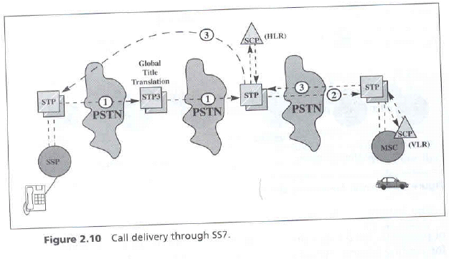
Fig. 2.10 Call delivery through SS7

Slide 56
Cache Scheme
Two possible positions for the cache,
  Method 1: The cache is maintained in the originating SSPs.
  Method 2: The cache is maintained in the STP that performs GTTs.
A cache entry consists of two fields:
  The MIN of an MS
  The current visited VLR of the MS
The cache contains entries for MSs recently accessed from the SSP.

Slide 57
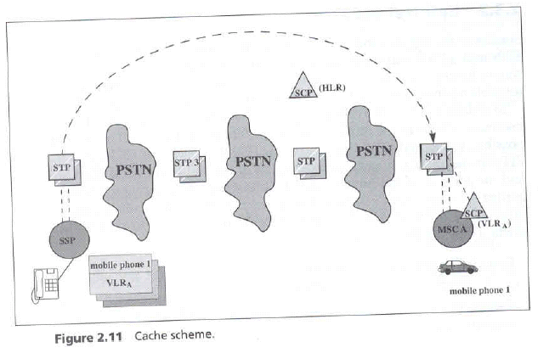
Fig. 2.11 Cache scheme

Slide 58
Cont.
When the calling party originates a call to an MS, the SSP first checks if the cache entry for the MS exists. Three possibilities are
  Case 1: The cache entry does not exists
    The call delivery is processed following the normal procedure.
  Case 2: The cache entry exists and is current
    The VLR is directly accessed.

Slide 59
Cont.
  Case 3: The cache entry exists but is obsolete
    Then procedure detects that the cache entry is obsolete if the queried VLR’s response is negative. The normal procedure is executed.

Slide 60
2.4 Roaming Management for CT2
In a public environment, CT2 is a one-way calling PCS system
  A CT2 handset can originate calls, but cannot receive incoming calls.
To construct two-way calling mechanism into CT2

Slide 61
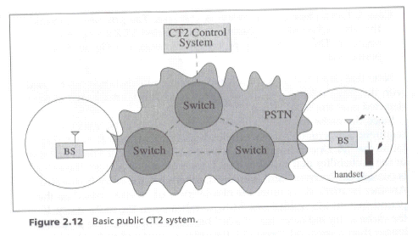
2.4.1 Basic Public CT2 System (One-Way Calling)
Fig. 2.12 Basic public CT2 system

Slide 62
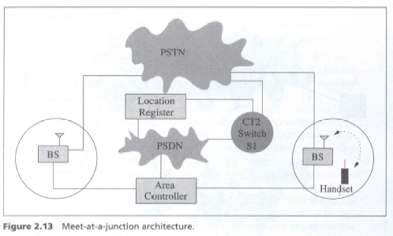
Fig. 2.13 Meet-at-junction architecture (Two-Way Calling)

Slide 63
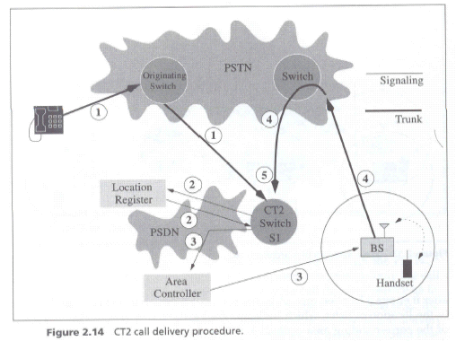
Fig. 2.14 CT2 call delivery procedure

Slide 64
Call Delivery Procedure
Step 1
  When the calling party dials the number of a CT2 handset, a voice trunk is set up from the originating switch to the CT2 switch S1.
Step 2
  S1 queries the location register to identify the area controller of the handset.

Slide 65
Cont.
Step 3
  An alerting message is sent from S1 to the corresponding area controller via the PSDN.
  The area controller then broadcasts the alerting message to the connected BSs to page the handset.
Step 4
  If the handset responds, the corresponding base station redials to S1 through PSTN.
Step 5.
  S1 bridges the two trunks, and the conversation begins.

